Slide 1
Environmental Studies Unit 2
Natural Resources and
Sustainable Development

Slide 2
Resources
A resource can be defined as “means of attaining given ends”.
In simple word it can be defined as “a natural stuff or manmade product which satisfies human needs or wants directly or indirectly.
An Endowment is any natural stuff that exists in environment, the use of which is not known to man at present.
The “Potential resources are that natural stuff that exists in the environment”, whose use and value is known to man but the stuff is not in use at present to satisfy human needs or wants.
So the resource is not a static but a dynamic concept.

Slide 3
Classification of Resources
Frequency of occurrence
Ubiquitous – Air, Sunlight
Localized – Coal, oil
B) Ownership of resources
Individual resources - land, house
National resources – rivers, forests
International resources - sunlight, Oceans
C) Nature of resource
Organic or biotic resources – forests, fish, crops
Inorganic or abiotic resources - minerals, rocks

Slide 4
D) On the basis of durability, availability and regeneration
Natural / Physical Resources
Inexhaustible / Renewable/flow resources – air, water
Automatically renewable
Renewable with efforts of man
Exhaustible/ Non renewable resources
Recyclable
Non recyclable
2. Human/ Cultural

Slide 5
Factors influencing resources
Cost benefit ratio
Cheaper substitutes
Availability of Capital
Market and it’s size
Availability of skilled labors
Customs and traditions of people
Political factors
Resource policy

Slide 6
Methods of Conservation
Substitution
Recycling
Innovation
Minimization of waste
Enforcement of Laws
Correct Estimation
Policy of conservation

Slide 7
Resource Utilisation and Sustainability
Find substitute to certain resources which are limited. E.g. Coal, Oil.
Waste generated should be easily degradable or its recycling.
Overexploitation of resources must be avoided.
Some strategies for conservation of resources should be formed.
5. Some strategies should be formed while exploiting natural resources.

Slide 8
Rio Declaration 1992
All people shall have healthy and productive life in harmony with nature.
Nations to take precaution to protect environment.
Nations shall constitute an integral part of the development process.
All nations shall cooperate to conserve resources, protect and restore the health and ecosystems.
All nations shall reduce and eliminate unsustainable patterns of production and consumption.
Nations shall encourage public awareness and participation.
All nations shall enact all environmental laws and develop their own national laws
Nations shall co-operate to promote an open international economic system.
All nations shall inform each other about natural disasters or activities which may have harmful impacts on other neighboring nations.
All nations shall share knowledge and innovative technologies to achieve the goal of sustainability.

Slide 9
Conventional and Non conventional Energy Resources
Conventional - Resources which are neither reusable nor recyclable.
Coal
Oil
Natural Gas
Water power
Nuclear energy
Non conventional- Renewable energy resources.
Solar energy
Wind energy
Tidal energy
Biogas energy
Geothermal energy
Alcohol from biomass

Slide 10
Energy resource
Growing energy demand for growing population, industries, transport sector, growing urban population, for growing consumerism, wastage of energy resources.
Mitigation and measures for energy conservation
Creation of awareness
Improving efficiency of equipments, machinery, appliances etc.
Energy or fuel conservation
Compulsory energy audits
Development of non conventional energy resources
Improve power sector in India
Increasing use of railways and public transport.
Improvement in vehicle design, road conditions.
Reforms in energy policy.
The imposition of a carbon tax.

Slide 11
Measures to solve energy crisis
Awareness
Improve the efficiency of equipments and upgrade equipments.
Use of non conventional energy resources
Maintaining energy audits
Conservation of sound ecosystem
Improve power sector in India
Modernization of power plants
Cut on subsidies in power sector.
Increasing share of railways and public transport
Promoting efficient practices for conservation in household sector.

Slide 12
Koyna hydroelectricity

Slide 13
Tarapur Nuclear power plant

Slide 14
Solar plant, 3 MW, Mulshi

Slide 15
Wind power plant

Slide 16
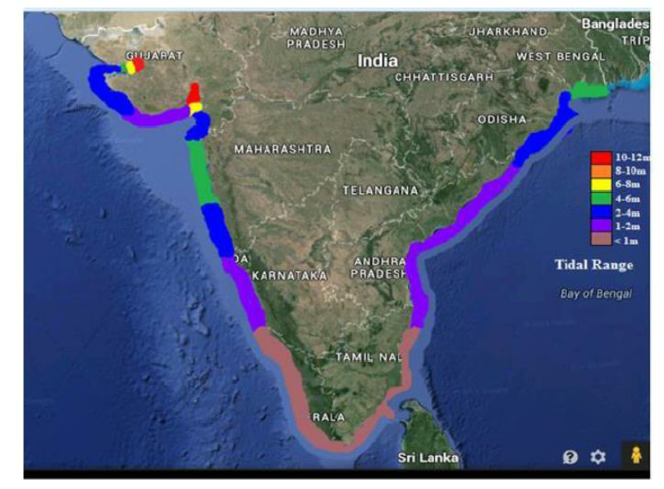
Tidal power

Slide 17
Biogas

Slide 18
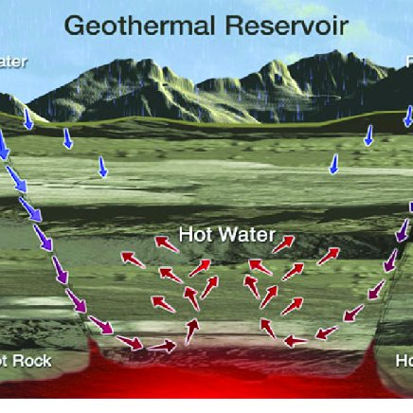
Geothermal energy, Gujarat

Slide 19
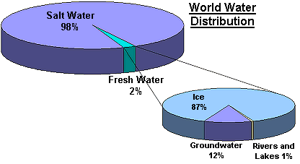
Water Resource
Distribution of water

Slide 20
Sources of water
Oceans
Snow, Glaciers
Groundwater
Rivers and streams
Lakes and ponds
Wetlands
The atmosphere

Slide 21
Water Pollution
Sewage
Industrial Effluents
Eutrophication
Sedimentation and Silting
Radioactive waste
Thermal pollution

Slide 22
Water Management
Construction of small dams
Conservation in agricultural sector
Conservation in urban areas
Water shed management
Rain water harvesting
Reclaiming wetlands
Forest belt
Controlling water pollution

Slide 26
Forest Resources
Importance
Ecological Balance
Food
Fuel
Forest products
Medicines
Raw material

Slide 27
Distribution of forest

Slide 28
A. Tropical hardwood forest (0 to 30 degree N & S of equator)
Wet equatorial forest: Hot and wet climate. Congo basin of Africa, Amazon basin of South America, Indonesia, Malaysia, Philippines. These forests contribute for 5.20% forest area of the world. Dense forest with tall trees. E.g. Ebony, Mahogany, Rosewood, Ironwood, Brazil nut, Rubber.
Monsoon forest: Semi evergreen trees. India, Myanmar, Thailand etc.
This forest contribute for 9% forest area of the world. These forests are broad leafed and shed leaves during dry season so called as deciduous forest. E.g Teak, Sal, Sandalwood, Mango, Neem.
B. Temperate hardwood forests. (30 to 50 degree N & S latitudes)
Temperature and rainfall is moderate. N.W. Europe, N.E. United States of America, S. W. Siberia. Japan, Korea, China. These forests contribute for 13% of forest area of the world. E.g. Oak, Birch, Maple, Walnut, Chestnut

Slide 29
C . Temperate softwood coniferous or Taiga forests. (30 to 50 degree N & S latitudes)
This forest covers a broad belt of land in N. America and Eurasia. Climate is cold, with precipitation in the form of snow. Trees have conical shape with needle shape leaves. These forests contribute for 25 % forest area of the world. E.g. Pine, Spruce, Birch, Haddock. Countries are Canada, U.S.A, Norway, Sweden, Finland and Eastern Russia.

Slide 30
Causes of deforestation
Agriculture and grazing
Beef for World Market
Commercial logging
Logging concessions
Raising of crops

Slide 31
Effects of deforestation
Atmospheric pollution
Disturbances in hydrological cycle
Deforestation
Loss of biodiversity
Increased rate of soil erosion
Increased risk of landslides
Economic losses

Slide 32
Forest management- Afforestation

Slide 33
Forest Management/ Measures to solve forest problems
Afforestation
Improved cutting practices
Control forest fire
Control on pest and diseases on forest
Reduce wastage of forest products
Use of substitute products
Increase the area under forest cover
Stop indiscriminate lumbering
Increase logging taxes

